Slide 1
WELCOME TO
DATA SCIENCE
Aleks Ontman & Alex Sherman

Slide 2
LEARNING OBJECTIVES
WELCOME TO DATA SCIENCE
Describe the roles and components of a successful learning environment
Define data science and the data science workflow
Apply the data science workflow to meet your classmates
Setup your development environment and review python basics

Slide 3
DATA SCIENCE
PRE-WORK

Slide 4
PRE-WORK REVIEW
Define basic data types used in object-oriented programming
Recall the Python syntax for lists, dictionaries, and functions
Create files and navigate directories using the command line interface

Slide 5
DATA SCIENCE
WELCOME TO GA!

Slide 6
WELCOME TO GA!
General Assembly is a global community of individuals empowered to pursue the work we love.
General Assembly’s mission is to build our community by transforming millions of thinkers into creators.

Slide 7

FEEDBACK/SUPPORT
Access to EIRs: office hours, in class support
Exit Tickets
Mid-Course Feedback
End of Course Feedback

Slide 8

GA GRADUATION REQUIREMENTS

Slide 9

FOREVER AND EVER

Slide 10
INTRODUCTION
WHAT IS DATA SCIENCE?

Slide 11
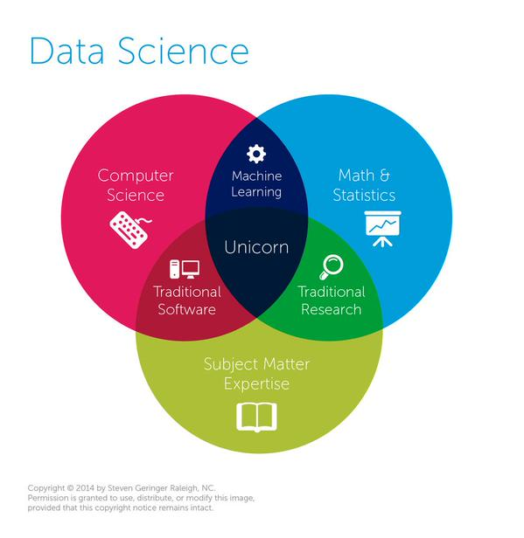
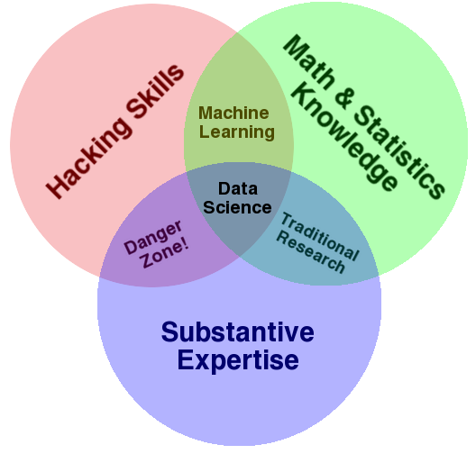
WHAT IS DATA SCIENCE?
A set of tools and techniques for data
Interdisciplinary problem-solving
Application of scientific techniques to
practical problems

Slide 12
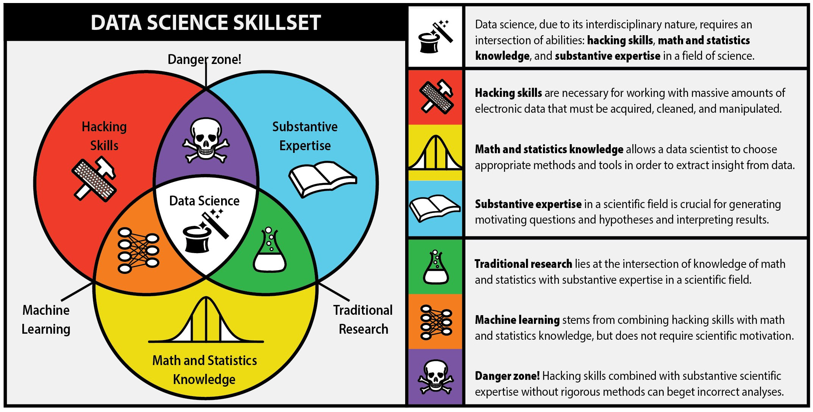
WHAT IS DATA SCIENCE?
Notes:
Image Source: The first rule of data science http://berkeleysciencereview.com/article/first-rule-data-science/

Slide 13
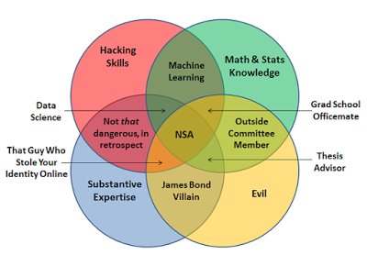
WHAT IS DATA SCIENCE?
http://joelgrus.com/2013/06/09/post-prism-data-science-venn-diagram/
Notes:
Image Source: The first rule of data science http://berkeleysciencereview.com/article/first-rule-data-science/

Slide 14





WHO USES DATA SCIENCE?

Slide 15
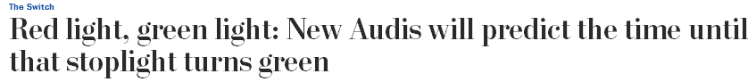

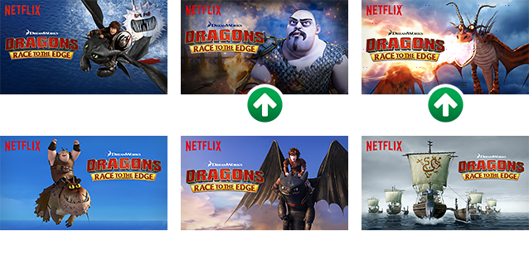
WHO USES DATA SCIENCE?
Article
Article

Slide 16
WHO USES DATA SCIENCE?
Can you think of others?

Slide 17

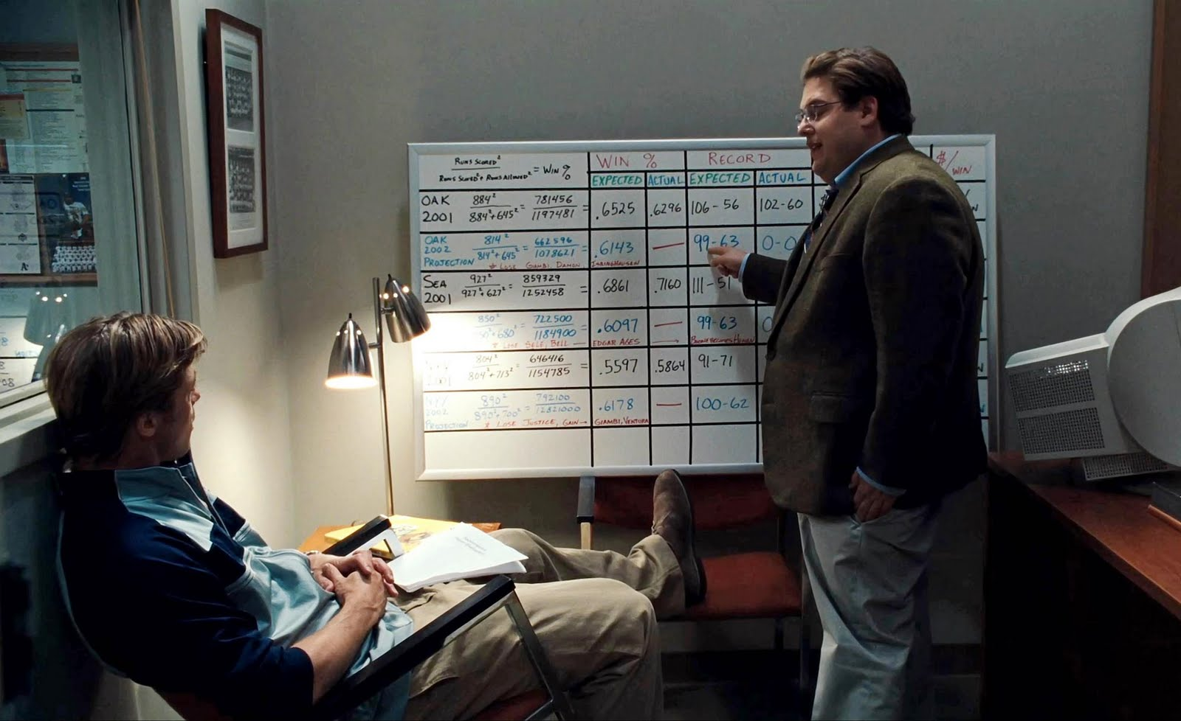
WHAT IS DATA SCIENCE?

Slide 18
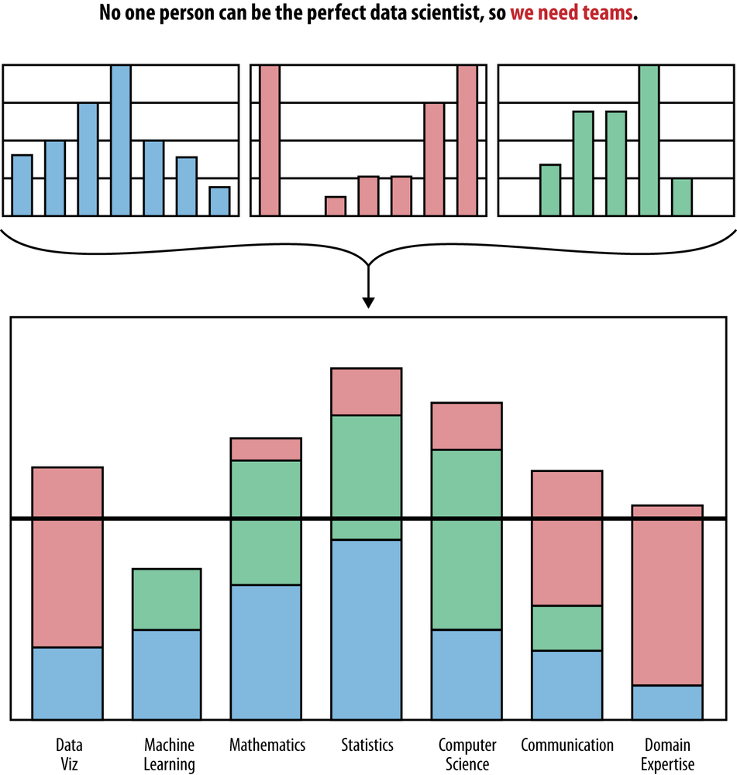
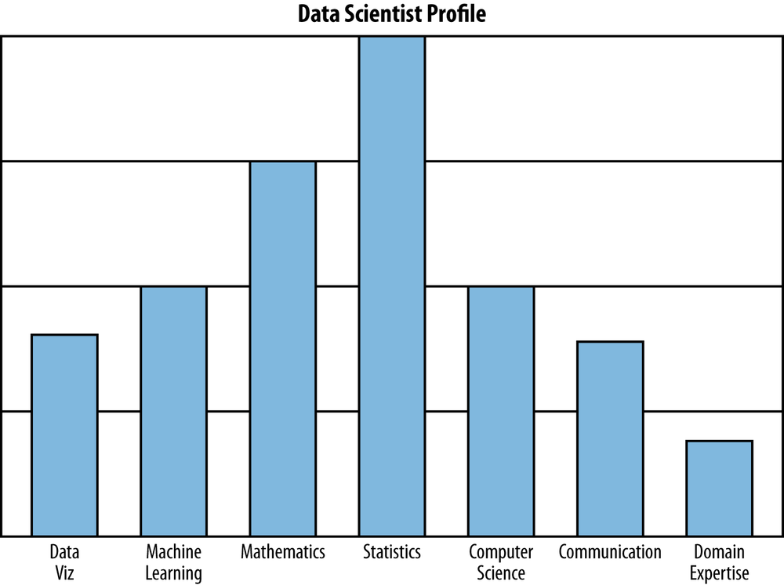
WHAT IS DATA SCIENCE?
Notes:
Image Source: Doing Data Science https://www.safaribooksonline.com/library/view/doing-data-science/9781449363871/ch01.html

Slide 19
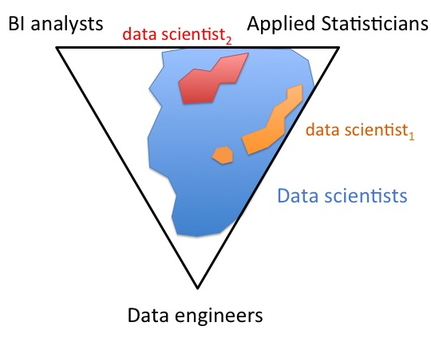
WHAT ARE THE ROLES IN DATA SCIENCE?

Slide 20
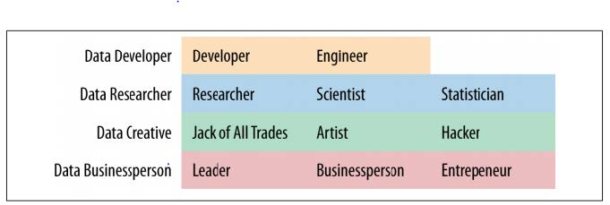
WHAT ARE THE ROLES IN DATA SCIENCE?
Data Science involves a variety of roles, not just one.

Slide 21
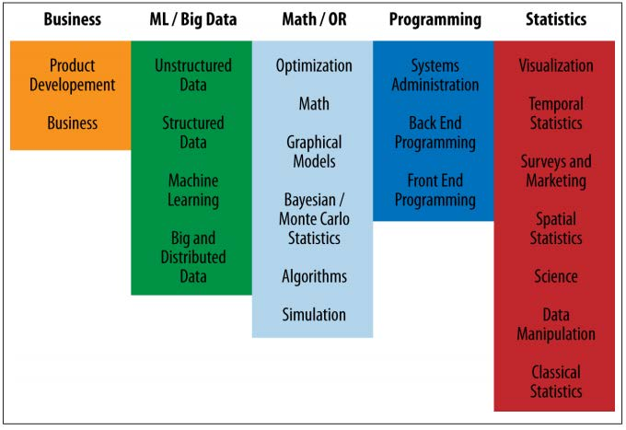
WHAT ARE THE ROLES IN DATA SCIENCE?
Data Science involves a variety of skill sets, not just one.

Slide 22
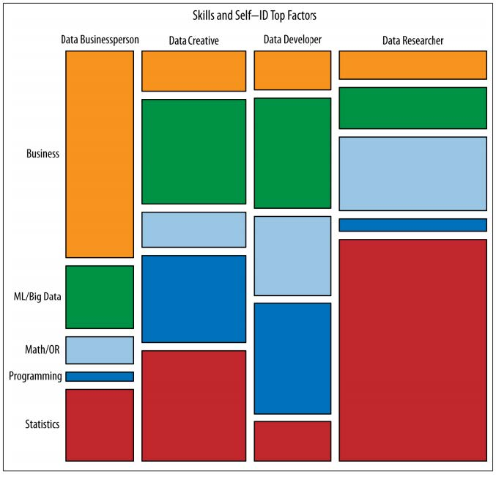
WHAT ARE THE ROLES IN DATA SCIENCE?
These roles prioritize different skill sets.
However, all roles involve some part of each skillset.
Where are your strengths and weaknesses?

Slide 23
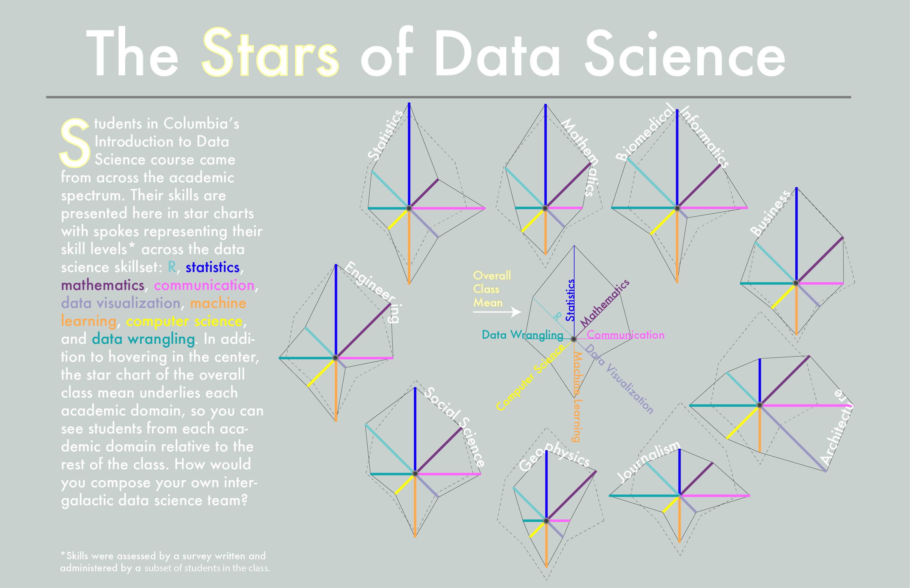
WHAT ARE THE ROLES IN DATA SCIENCE?

Slide 24
INTRODUCTION
THE DATA SCIENCE WORKFLOW

Slide 25
OVERVIEW OF THE DATA SCIENCE WORKFLOW
A methodology for doing Data Science
Similar to the scientific method
Helps produce reliable and reproducible results
Reliable: Accurate findings
Reproducible: Others can follow your steps and get the same results

Slide 26
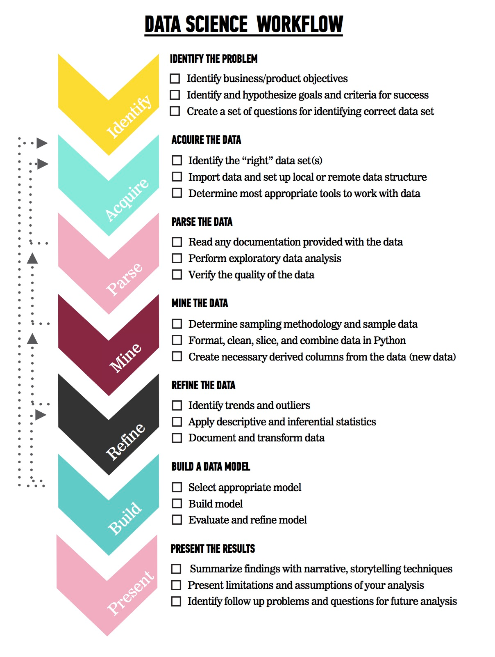
OVERVIEW OF THE DATA SCIENCE WORKFLOW
The steps:
Identify the problem
Acquire the data
Parse the data
Mine the data
Refine the data
Build a data model
Present the results

Slide 27
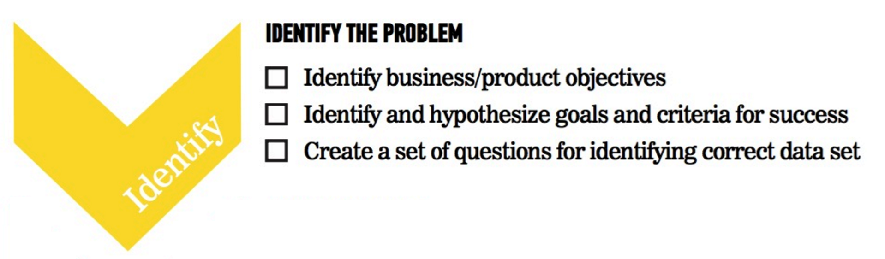
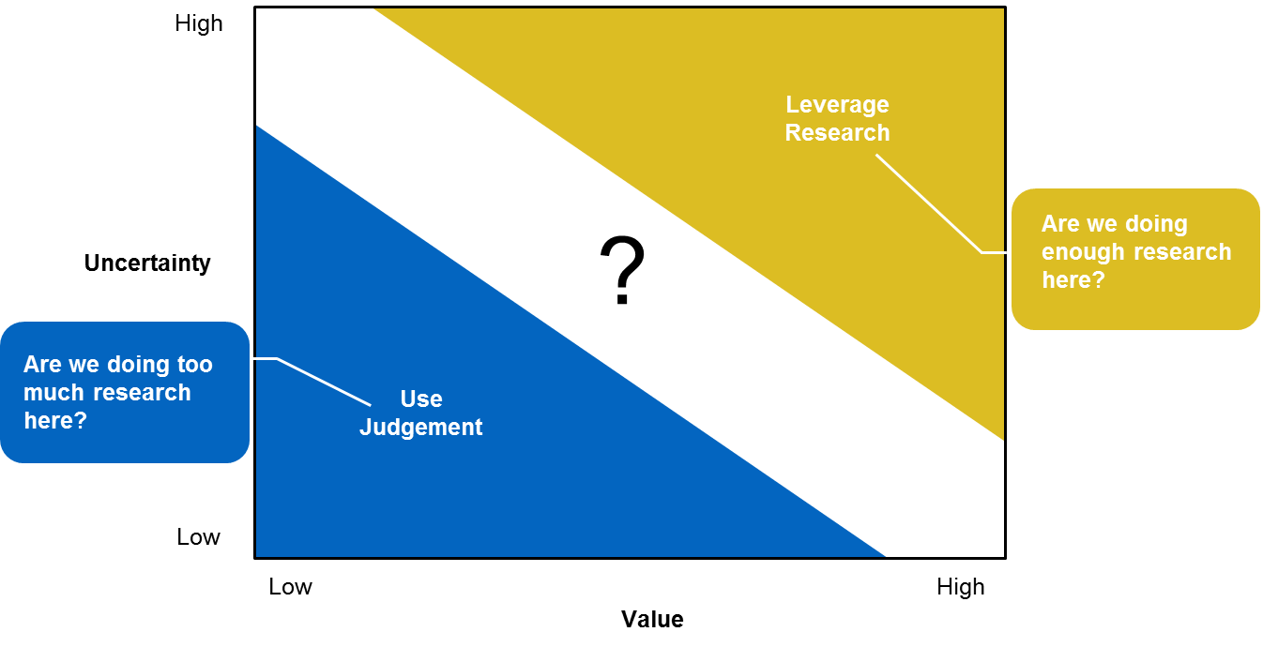
OVERVIEW OF THE DATA SCIENCE WORKFLOW

Slide 28
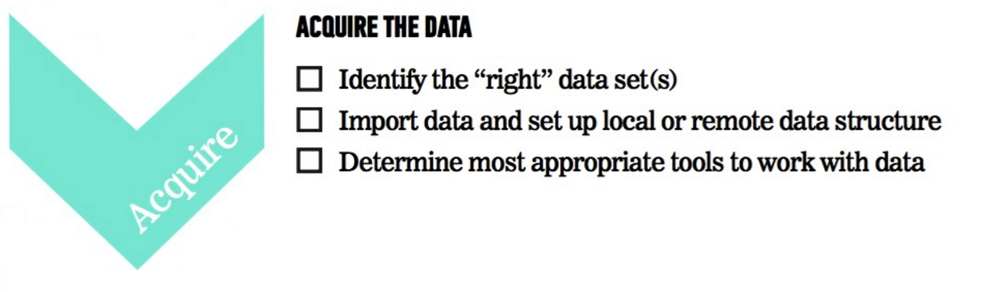
OVERVIEW OF THE DATA SCIENCE WORKFLOW

Slide 29
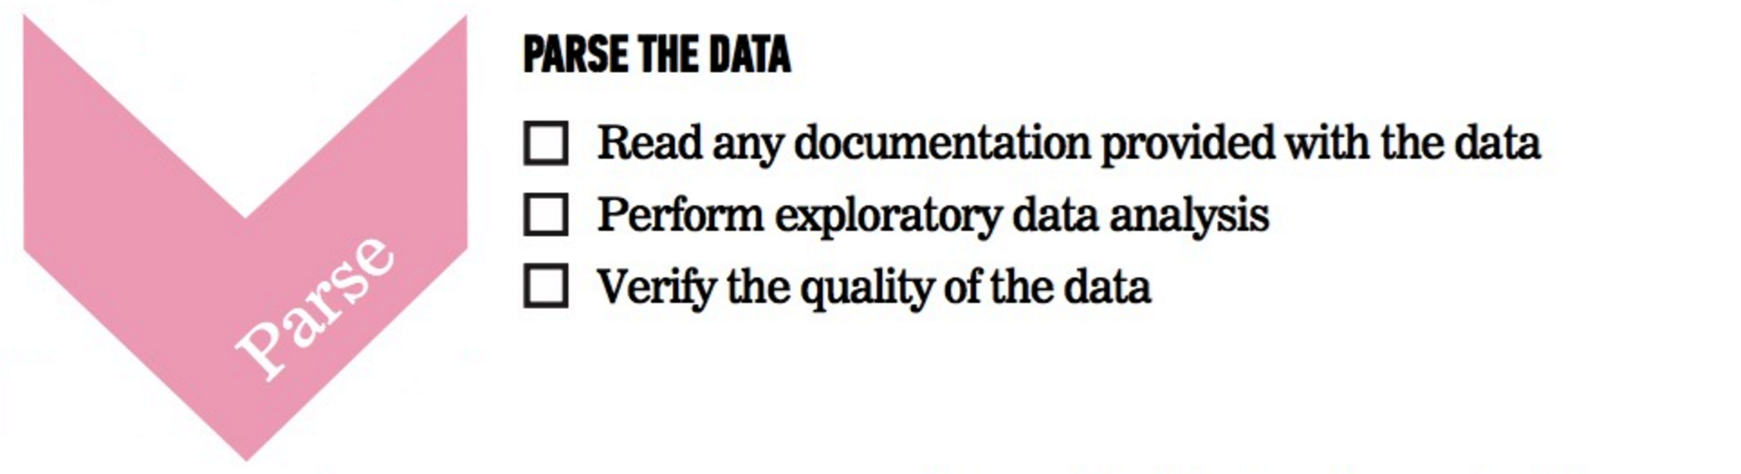
OVERVIEW OF THE DATA SCIENCE WORKFLOW

Slide 30
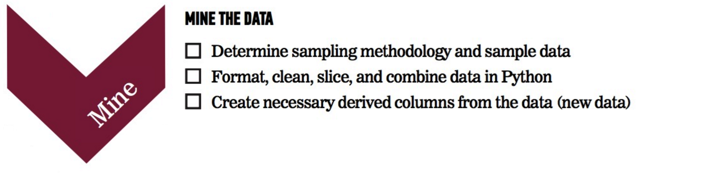
OVERVIEW OF THE DATA SCIENCE WORKFLOW

Slide 31
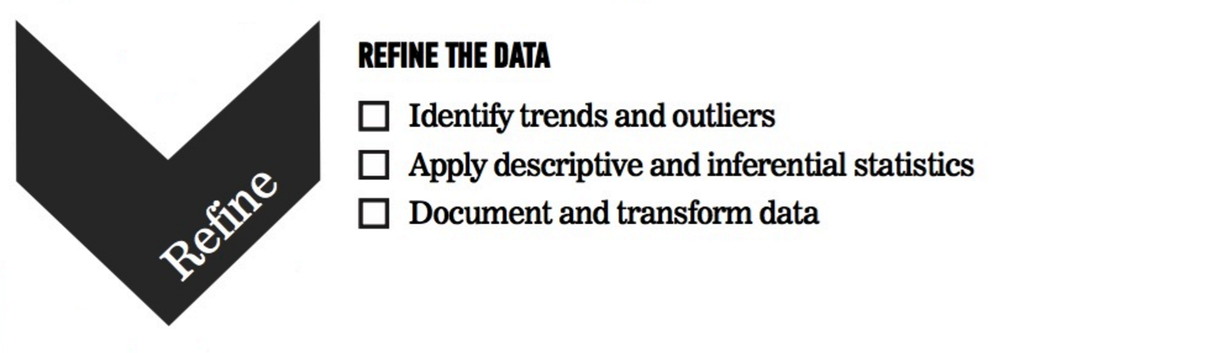
OVERVIEW OF THE DATA SCIENCE WORKFLOW

Slide 32

OVERVIEW OF THE DATA SCIENCE WORKFLOW

Slide 33

OVERVIEW OF THE DATA SCIENCE WORKFLOW

Slide 34
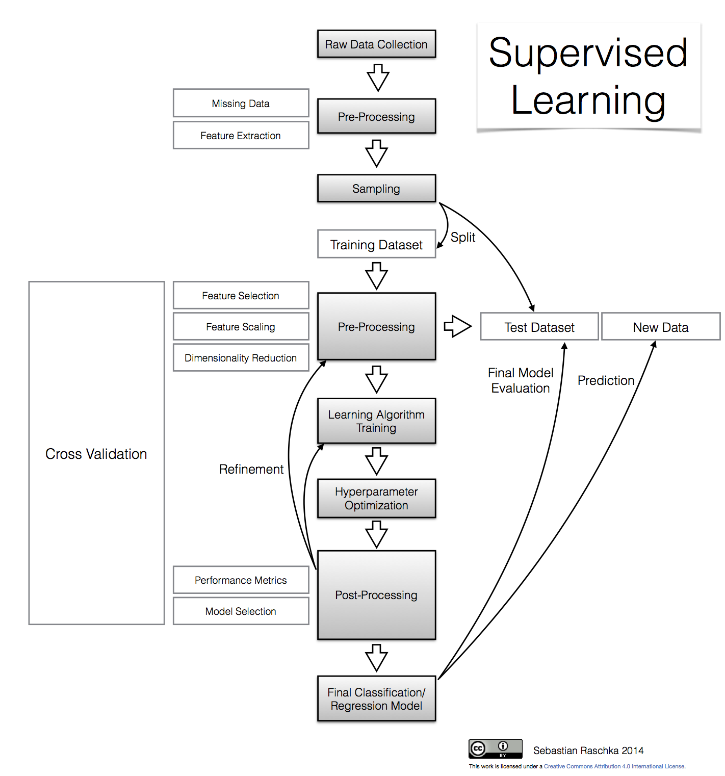
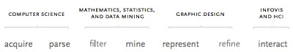
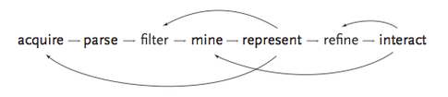
OVERVIEW OF THE DATA SCIENCE WORKFLOW
Interdisciplinary
Recursion

Slide 35
GUIDED PRACTICE
DATA SCIENCE WORK FLOW EXERCISE

Slide 36

ACTIVITY: DATA SCIENCE WORKFLOW
DIRECTIONS (25 minutes)
EXERCISE
Divide into 4 groups, each located at a whiteboard.
IDENTIFY: Each group should develop 1 research question they would like to know about their classmates. Create a hypothesis to your question. Don’t share your question yet! (5 minutes)
ACQUIRE: Rotate from group to group to collect data for your hypothesis. Have other students write or tally their answers on the whiteboard. (10 minutes)
PRESENT: Communicate the results of your analysis to the class. (10 minutes)
Create a narrative to summarize your findings.
Provide a basic visualization for easy comprehension.
Choose one student to present for the group.
DELIVERABLE
Presentation of the results

Slide 37
DEMO
ENVIRONMENT SETUP

Slide 38




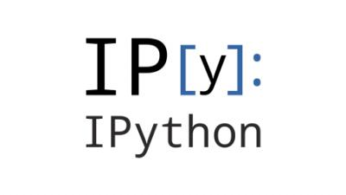

DEV ENVIRONMENT SETUP
A Brief Intro to Our Environment
IPython Notebook Test and Python Review

Slide 39
DEV ENVIRONMENT SETUP
Brief intro of tools
Environment setup
Create a Github account
Install Python 2.7 and Anaconda
Practice Python syntax, Terminal commands, and Pandas
iPython Notebook test and Python review

Slide 40
DEV ENVIRONMENT SETUP
Test your new setup using the lesson 1 starter code available at /lessons/lesson-1/code/starter-code/lesson1-starter-code.ipynb in the Github repo
Ask your classmates and instructor for help if you have problems!

Slide 41
CONCLUSION
REVIEW

Slide 42
CONCLUSION
You should now be able to answer the following questions:
What is Data Science?
What is the Data Science workflow?
How can you have a successful learning experience at GA?

Slide 43
DATA SCIENCE
BEFORE NEXT CLASS

Slide 44
DUE DATE
BEFORE NEXT CLASS
Project: Begin work on Project 1

Slide 45
WELCOME TO DATA SCIENCE
Q & A

Slide 46
WELCOME TO DATA SCIENCE
EXIT TICKET
DON’T FORGET TO FILL OUT YOUR EXIT TICKET

